Slide 1
PYTHON
Abhinash Mishra

Slide 2

Python
Python is a widely used high-level programming language for general-
purpose programming, created by Guido van Rossum and first released
in 1991.
Guido van Rossum was big fan of Monty Python's Flying Circus and
hence had given the name of this programming language as Python.
Python uses a syntax that allows programmers to express concepts in
fewer lines of code than might be used in languages such as C++ or Java.

Slide 3
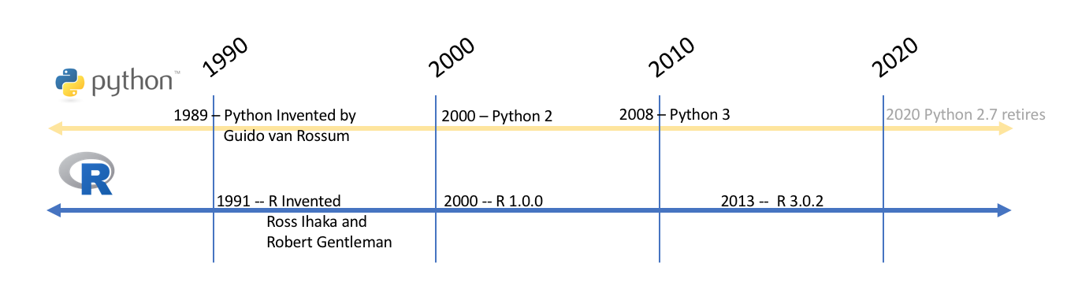

Slide 4
Python is a high-level, interpreted, interactive and object-oriented scripting language. Python is designed to be highly readable. It uses English keywords frequently where as other languages use punctuation, and it has fewer syntactical constructions than other languages.
Python is Interpreted − Python is processed at runtime by the interpreter. You do not need to compile your program before executing it. This is similar to PERL and PHP.
Python is Interactive − You can actually sit at a Python prompt and interact with the interpreter directly to write your programs.
Python is Object-Oriented − Python supports Object-Oriented style or technique of programming that encapsulates code within objects.
Python is a Beginner's Language − Python is a great language for the beginner-level programmers and supports the development of a wide range of applications from simple text processing to WWW browsers to games.

Slide 5
Python Features
Python's features include −
Easy-to-learn − Python has few keywords, simple structure, and a clearly defined syntax. This allows the student to pick up the language quickly.
Easy-to-read − Python code is more clearly defined and visible to the eyes.
Easy-to-maintain − Python's source code is fairly easy-to-maintain.
A broad standard library − Python's bulk of the library is very portable and cross-platform compatible on UNIX, Windows, and Macintosh.
Interactive Mode − Python has support for an interactive mode which allows interactive testing and debugging of snippets of code.
Portable − Python can run on a wide variety of hardware platforms and has the same interface on all platforms.
Extendable − You can add low-level modules to the Python interpreter. These modules enable programmers to add to or customize their tools to be more efficient.

Slide 6
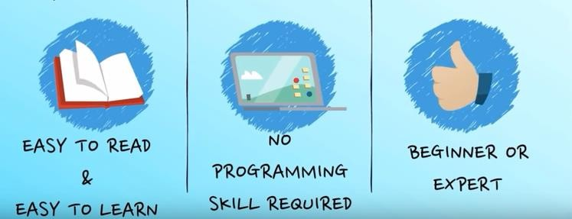
Databases − Python provides interfaces to all major commercial databases.
GUI Programming − Python supports GUI applications that can be created and ported to many system calls, libraries and windows systems, such as Windows MFC, Macintosh, and the X Window system of Unix.
Scalable − Python provides a better structure and support for large programs than shell scripting.

Slide 7
Python is available on a wide variety of platforms including Linux and Mac OS X. Let's understand how to set up our Python environment.
Local Environment Setup
Integrated Development Environment
You can run Python from a Graphical User Interface (GUI) environment as well, if you have a GUI application on your system that supports Python.
Unix − IDLE is the very first Unix IDE for Python.
Windows − PythonWin is the first Windows interface for Python and is an IDE with a GUI.
Macintosh − The Macintosh version of Python along with the IDLE IDE is available from the main website, downloadable as either MacBinary or BinHex'd files.
If you are not able to set up the environment properly, then you can take help from your system admin. Make sure the Python environment is properly set up and working perfectly fine.

Slide 8
WebDevelopment: Django, Pyramid, Bottle, Tornado, Flask, web2py
GUIDevelopment: tkInter, PyGObject, PyQt, PySide, Kivy, wxPython
Scientific and Numeric: SciPy, Pandas, IPython
Software Development: Buildbot, Trac, Roundup
System Administration: Ansible, Salt, OpenStack

Slide 9
PYTHON CODE
PL
BIL

Slide 10
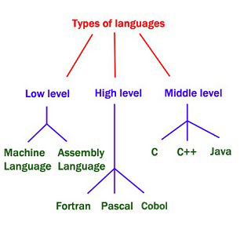
PYTHON

Slide 11
Why Python is called Dynamically Typed?
# This will store 6 in the memory and binds the # name x to it. After it runs, type of x will # be int. x = 6 print(type(x)) # This will store 'hello' at some location int # the memory and binds name x to it. After it # runs type of x will be str. x = 'hello' print(type(x))

Slide 12
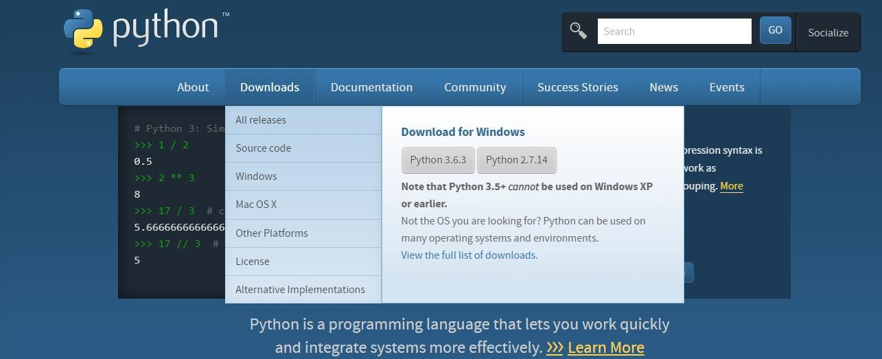
Installation of Python 3.6.3
Steps for Installing Python
1. Download the latest Python build from www.python.org as shown in Figure 1 below.
When you double click on Python 3.6.3, Python installer file will be downloaded in “Download”
folder.

Slide 13
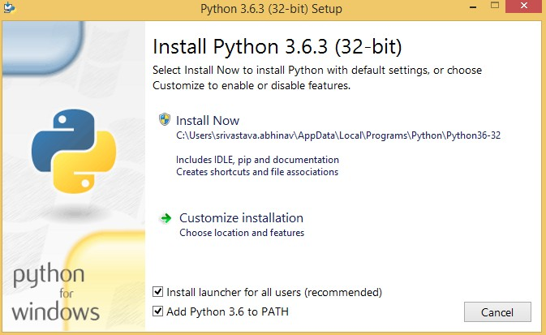
Installation of Python 3.6.3
2. Double click the downloaded Python installer file to start the installation. You will be presented
with the options as shown in Figure 3 below. Make sure that ”Add Python 3.6 to PATH” checkbox is
ticked.
Click the Install Now and Python 3.6.3 install will proceed.

Slide 14
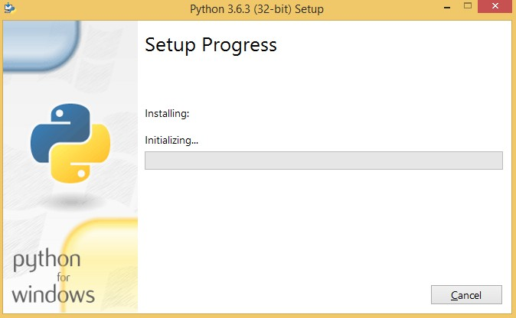
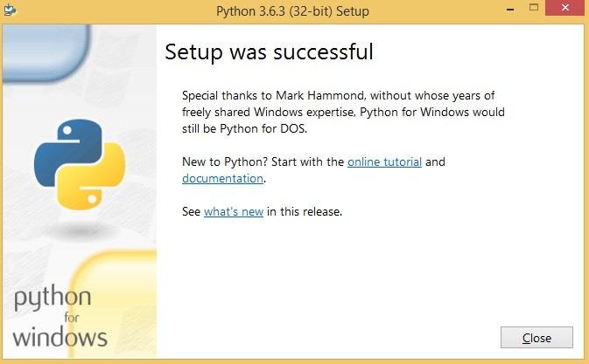
Installation of Python 3.6.3
This shows the successful installation of Python 3.6.3

Slide 15
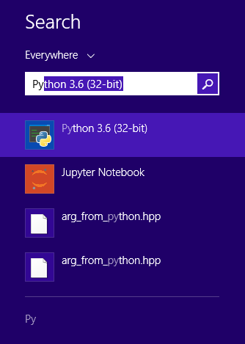
Installation of Python 3.6.3
3. Once the installation has successfully completed, Python 3.6.3 will be installed and available from the
Windows Search Menu. Run Python 3.6 (32-bit) from the start menu. It can be found in the Python folder
as shown in Figure below.
Click on Python 3.6 and it provides an interactive console that gives a way to immediately write Python
code and see the results in real time – Shown in next slide

Slide 16
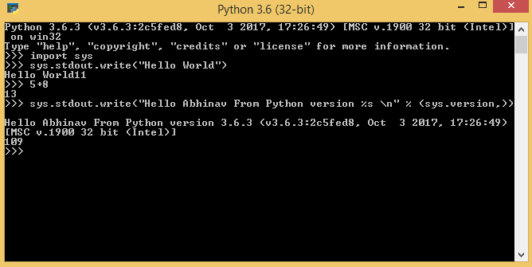
Installation of Python 3.6.3

Slide 17
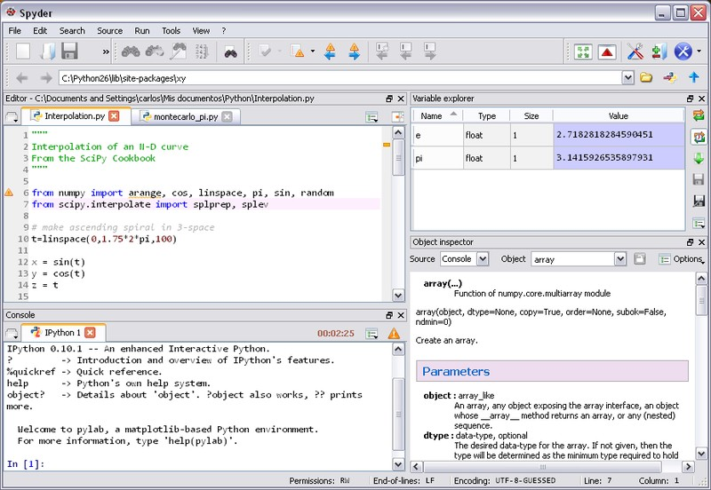
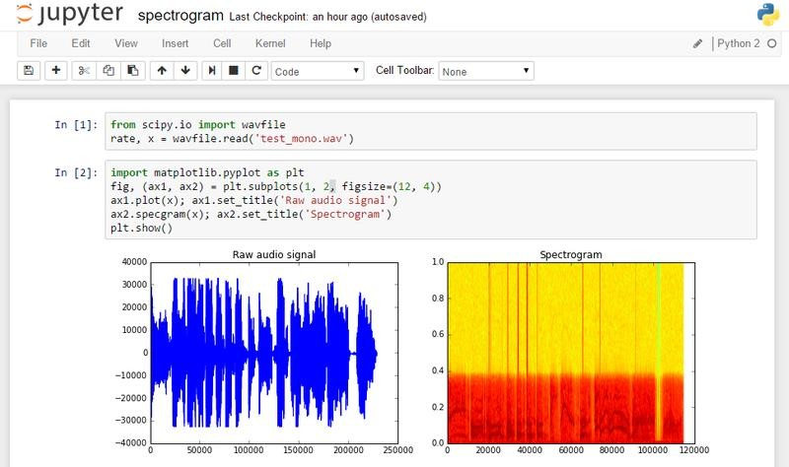
IDE for Python -> Integrated Development Environment
It’s a coding tool which allows you to write, test and debug your code in an easier way, as they typically
offer code completion or code insight by highlighting, resource management, and debugging tools.
•
•
•
•
•
Spyder
Jupyter
Atom
Pycharm
Rodeo
Spyder
Jupyter

Slide 18
Anaconda Installation – Many problems one solution
1.
Conda is an open source package management system and environment management system that
runs on Windows, macOS and Linux.
Conda quickly installs, runs and updates packages and their dependencies.
Conda easily creates, saves, loads and switches between environments on your local computer.
It was created for Python programs, but it can package and distribute software for any language.
Conda as a package manager helps you find and install packages.
The conda package and environment manager is included in all versions of Anaconda.
If we install Anaconda – Spyder, Jupyter, and even Python latest version would also be installed
simultaneously.
To install Anaconda -> Click on to the following links
https://www.anaconda.com/download/
2.
3.
4.
5.
6.
7.
8.
9.
Anaconda package which provides code completion and linking for Python and takes care of the
basics, there are tons of themes, lightning fast user interface, easy configuration, tons of
packages for more power features

Slide 19
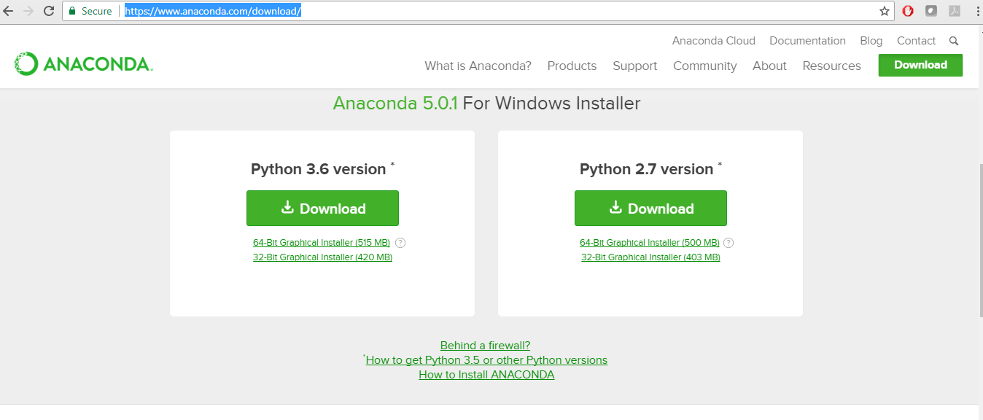
Anaconda installation
To download Anaconda click here and install it. Jupyter, Spyder and
python will be installed simultaneously.

Slide 20
Concept of Program and Programming
Program: Stored Set of instruction
Programming: The Act of writing down these set of instructions
Programmer: A person/machine skilled in programming
--------------------------THAT’S OUR AIM
Programming Language:
Vocabulary and grammar
To write set of instruction.
SOFTWARE
WHAT NEXT ?
NETWORK
I/O
DEVICE
CPU
MAIN MEMORY
SEC-MEMORY

Slide 21
Basic Python Module for Machine Learning
Data Type
Number
String
Lists
Tuples
Dictionary
Mutable and immutable data types

Slide 22
counter = 100 # An integer assignment
miles = 1000.0 # A floating point
name = "John" # A string
#name=‘sam’------“sam”------‘”sam’”
Print counter
print miles
print name

Slide 23
Tuples: Values Separated by commas( usually enclosed by parenthesis) and can hold any data type(immutable)
A=(4, ”Ture” ,True,34.8)
Float
Integer
String
Boolean

Slide 24
List: Values Separated by commas( usually enclosed by square bracket) and
can hold any data type(immutable)
A=[4, ”Ture” ,True,34.8]
Float
Integer
String
Boolean

Slide 25
Dictionaries: Enclosed in curly brackets, elements separated by commas usually KEY:VALUE pair by colon
DICT_VAR= {1:”L”, 2:”II”,3:”III”, name:”john”, var: 45}
Value
Key

Slide 26
Mutable and Immutable data types
IMMUTABLE : Data Types which once created we cannot modify them are known as
Immutable String and Tuple are immutable.
My_String = “HELLO WORLD!”
My_Tuple= (1,45.8,True,”BOB”)
MUTABLE : Data Types which once created we can modify them are known as Immutable
list and Dictionaries are immutable.
My_List =[1,True,”bob”]
My_Dic= {1:45,2:45.8,3:True,name:”BOB”}

Slide 27
Assigning Values to Variables
•
The operand to the left of the = operator is the name of the variable
the = operator is the value stored in the variable.
and the operand to the
right
of
•
H = 5+5
H
10
•
Multiple Assignment
•
•
Here one is allotted to multiple
x = y = z = 1
variables. We
can assign objects
to multiple variables.

Slide 28
3.1 Python Identifier
•
Python identifier :-
–
Identifier is the name given to entities like class, functions, variables etc. in Python. It helps
differentiating one entity from another. It can be of any length.
–
Starts with a letter A to Z or a to z or an underscore (_) which is used to identify a
function, class, module or other object .
An identifier cannot start with a digit. 1variable is invalid, but variable1 is perfectly fine.
Keywords cannot be used as identifiers.
We cannot use special symbols like !, @, #, $, % etc. in our identifier.
Every class name start with capital letter.
Strange and strange are two different identifiers in python.
variable,
–
–
–
–
–
Strange
strange
starts with uppercase.
starts with lowercase.

Slide 29


3.2 Python Keywords
•
Python keywords are mentioned below. The following are keywords of python.
False Class finally is return
None
continue
from
lambda
while
True
def
for
nonlocal
try
and
del
global
not
with
as
elif
if
or
yield
assert
else
import
pass
break
except
in
raise

Slide 30
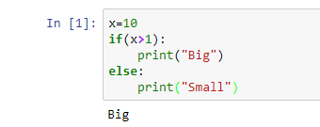
3.3 Lines And Indentation
•
•
Blocks of code are denoted by line indentation .
The two blocks of code in our example if-statement are both indented four spaces, which is a typical amount of indentation for Python
Here , there is four space indentation. It is
required to execute else there would be error.
All
the continuous lines indented with same number of spaces would form a block .

Slide 31
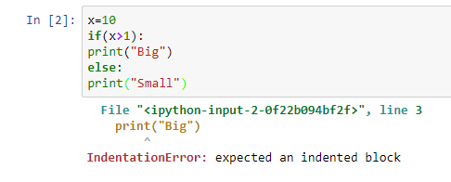
Generates Error
Here , we have not indented
four space, and written same
code. So, “Indentation Error”
takes place.

Slide 32
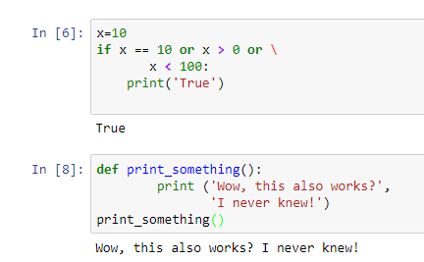
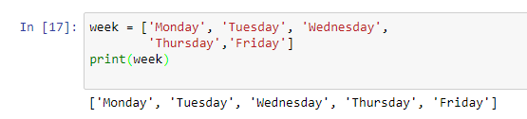
3.4 Multi_Line Statements
•
By using multi-line statements we can continue a line.
Example
:
“\” is used as continuation of line. It is
used universally (at any place)
“,” I used here as continuation of line, but
it is applicable only with print statement.
Statements
which
are in [], {}, or () brackets do not use the line continuation character.
For example:

Slide 33
3.5 Quotation in Python
•
•
Python accepts single ('), double (") and triple (''' or ")quotes to denote string literals.
Examples :
–
–
–
‘apple‘ ,
“welcome to python”,
''' This is another form to accept as string literals'''

Slide 34
3.6 Comments in Python
•
There are two types of comments in python.
1. single line comment
• It begins with the hash character ("#") This is the only way to comment on Python
2.Multiple line comment
• It doesn’t exist in python.

Slide 35
3.6 Comments in Python
3.Waiting for the User
• The statement saying “Press the enter key to exit”, this means it waits for the user’s action.
4.Multiple Statements on a Single Line
•
The semicolon ( ; ) allows multiple statements on the single line .

Slide 36
3.7 Suite
3.7. Multiple statement groups as suites
A
compound statement consists of one or more ‘clauses.’ A clause consists of a header and a ‘suite.’ The
clause headers of a particular compound statement are all at the same indentation level. Each clause
header begins with a uniquely identifying keyword and ends with a colon. A suite is a group of
statements controlled by a clause. A suite can be one or more semicolon-separated simple
statements on the same line as the header,
indented statements on subsequent lines.
following
the
header’s
colon,
or
it
can
be
one
or
more
If condition is met, then clause is executed
Each such clause is suite.
if_stmt ::= "if" expression ":" suite
( "elif" expression ":" suite )*
["else" ":" suite]

Slide 37
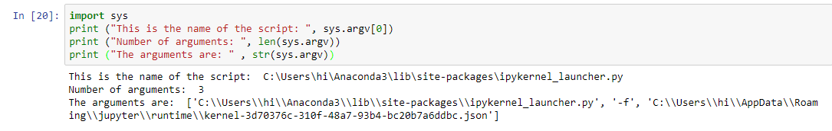
3.8. Command Line Arguments
An argument
program.
sent
to
a
program
being
called.
More
than
one
command
lines
are
accepted
by
the
sys.argv is a list in Python, which contains the command-line arguments passed to the script.
With the len(sys.argv) function you can count the number of arguments.
If you are going to work with command line arguments, you probably want to
use sys.argv.
To use sys.argv, you will first have to import the sys module.

Slide 38
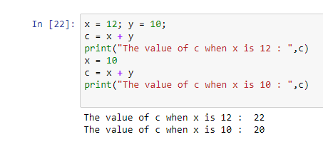
Variables
•
Variable is used to store data and to retrieve the data. That means, we can change its value .
It is not
fixed. Exampl
e :
Initially the value of x is
12, so it gives 22
After we changed it to
so it gives 20 .Hence
can change the values.
10,
we
In
•
python variables are case sensitive and consists of numbers, letters and underscore.
Reserved words should not be used as a variables names.
Example :
else , return ,and print etc.

Slide 39
Receiving input from Console
input() function is used to receive input from the console.
Syntax: input([prompt]) -> string
input() function accepts an optional string argument called prompt and returns a string.
>>> name = input("Enter your name: ")
>>> Enter your name: tim
>>> name 'tim'
Note that input() returns string even if you enter a number, to convert it to an integer you can use int() or eval() .
>> age = int(input("Enter your age: "))
Enter your age: 22
>>> age 22
>>> type(age)

Slide 40
Python numbers
This data type supports only numerical values like 1 , 31.4 .
Python 3 support 3 different numerical types.
1. int - for integer values like 45 .
2. float - for floating point values like 2.3 .
3. complex - for complex numbers like 3+2j .
Integers
Integer literals in python belong to int class.
>>> i = 100
>>> i 100
Floats
Floating points are values with decimal point like.
>>> f = 12.3 >>> f 12.3
One point to note that when one of the operands for numeric operators is a float value then the result will be in float value.
>>> 3 * 1.5
>>> 4.5

Slide 41
Complex number
As you may now complex number consists of two parts real and imaginary, and is denoted by j .You can define complex number like this:
>>> x = 2 + 3j
# where 2 is the real part and 3 is imaginary
Determining types
Python has type() inbuilt function which is use to determine the type of the variable.
>>> x = 12
>>> type(x)
<class 'int'>
Python operators
Python has the different operators which allows you to carry out required calculations in your program.
+ , - and * works as expected, remaining operators require some explanation.
/ - Float Division : / operator divides and return result as floating point number means it will always return fractional part. For e.g
>>> 3/2 1.5
// - Integer Division : // perform integer division i.e it will truncate the decimal part of the answer and return only integer.

Slide 42
>>> 3//2
1
** - Exponentiation Operator : This operator helps to compute ab (a raise to the power of b). Let's take an example:
>>> 2 ** 3
# is same as 2 * 2 * 2
>>>>8
% operator : % operator also known as remainder or modulus operator. This operator return remainder after division. For e.g:
>>> 7 % 2
1
Operator Precedence
In python every expression are evaluated using operator precedence. Let's take an example to make it clear.
>>> 3 * 4 + 1
In the above expression which operation will be evaluated first addition or multiplication? To answer such question we need to refer to operator precedence list in python. Image below list python precedence order from high to low.

Slide 43
Augmented Assignment Operator
These operator allows you write shortcut assignment statements. For e.g:
>>> count = 1
>>> count = count + 1
>>> count 2
by using Augmented Assignment Operator we can write it as:
>>> count = 1
>>> count += 1
>>> count 2

Slide 44
Python Strings
Strings in python are contiguous series of characters delimited by single or double quotes. Python don't have any separate data type for characters so they are represented as a single character string.
Creating strings
>>> name = "tom"
# a string
>>> mychar = 'a’
# a character
you can also use the following syntax to create strings.
>>> name1 = str()
# this will create empty string object
>>> name2 = str("newstring")
# string object containing 'newstring'
Strings in python are immutable.
What this means to you is that once string is created it can't be modified. Let's take an example to illustrate this point.
>>> str1 = "welcome“
>>> str2 = "welcome"
here str1 and str2 refers to the same string object "welcome" which is stored somewhere in memory. You can test whether str1 refers to same object as str2 using id() function.

Slide 45
What is id() : Every object in python is stored somewhere in memory. We can use id() to get that memory address.
>>> id(str1) 78965411
>>> id(str2) 78965411
As both str1 and str2 points to same memory location, hence they both points to the same object.
Let's try to modify str1 object by adding new string to it.
>>> str1 += " mike“
>>> str1 welcome mike
>>> id(str1)
>>> 78965579
As you can see now str1 points to totally different memory location, this proves the point that concatenation doesn't modify original string object instead it creates a new string object. Similarly Number (i.e int type) is also immutable.
Operations on string
String index starts from 0 , so to access the first character in the string type:
>>> name[0] # t
+ operator is used to concatenate string and * operator is a repetition operator for string.
>>> s = "tom and " + "jerry“
>>> print(s)

Slide 46
tom and jerry
>>> s = "this is bad spam " * 3
>>> print(s) this is bad spam this is bad spam this is bad spam
Slicing string
You can take subset of string from original string by using [] operator also known as slicing operator.
Syntax: s[start:end]
this will return part of the string starting from index start to index end - 1 .
Let's take some examples.
>>> s = "Welcome"
>>> s[1:3]
el
Some more examples.
>>> s = "Welcome"
>>> s[ : 6]
'Welcom'
>>> s[4 : ]
'ome'
>>> s[1 : -1]
'elcom’
Note: start index and end index are optional. If omitted then the default value of start index is 0 and that of end is the last index of the string.

Slide 47
ord() and chr() Functions
ord() - function returns the ASCII code of the character.
chr() - function returns character represented by a ASCII number.
>>> ch = 'b’
>>> ord(ch)
98
>>> chr(97)
'a’
>>> ord('A’)
65

Slide 48
>>> len("hello")
< 5 >
>>> max("abc")
<'c’>
>>> min("abc")
<'a’>
in and not in operators
You can use in and not in operators to check existence of string in another string. They are also known as membership operator.
>>> s1 = "Welcome“
>>> "come" in s1
>>>True
>>> "come" not in s1
>>> False
String comparison

Slide 49
You can use ( > , < , <= , <= , == , != ) to compare two strings. Python compares string lexicographically i.e using ASCII value of the characters.
Suppose you have str1 as "Jane" and str2 as "Jake" . The first two characters from str1 and str2 ( J and J ) are compared. As they are equal, the second two characters are compared. Because they are also equal, the third two characters (n and k ) are compared. And because 'n' has greater ASCII value than 'k' , str1 is greater than str2 .
Here are some more examples
Here are some more examples:
>>> "tim" == "tie"
False >>>
"free" != "freedom"
True >>>
"arrow" > "aron“
True >>>
"green" >= "glow“
True >>>
"green" < "glow“
False >>>
"green" <= "glow“
False >>>
"ab" <= "abc" True >>>

Slide 50
Iterating string using for loop
String is a sequence type and also iterable using for loop (to learn more about for loop click here).
>>> s = "hello"
>>> for i in s:
... print(i, end="")
hello
Note: By default print() function prints string with a newline , we change this behavior by supplying a second argument to it as follows.
print("my string", end="\n") #this is default behavior
print("my string", end="") # print string without a newline
print("my string", end="foo") # now print() will print foo after every string

Slide 51
Testing strings
String class in python has various inbuilt methods which allows to check for different types of strings.

Slide 52
>>> s = "welcome to python“
>>> s.isalnum() #False
>>> "Welcome".isalpha() #True
>>> "2012".isdigit() #True
>>> "first Number".isidentifier() #False
>>> s.islower() #True
>>> "WELCOME".isupper() #True
>>> " \t".isspace() # True
Searching for Substrings

Slide 53
Converting Strings

Slide 54
s = "string in python"
>>> s1 = s.capitalize() ### s1 'String in python’
>>> s2 = s.title() ### s2 'String In Python’
>>> s = "This Is Test“
>>> s3 = s.lower()
>>> s3 'this is test’
>>> s4 = s.upper()
>>> s4 'THIS IS TEST’
>>> s5 = s.swapcase()
>>> s5 'tHIS iS tEST’
>>> s6 = s.replace("Is", "Was")
>>> s6 'This Was Test’
>>> s 'This Is Test’
>>>

Slide 55
Operator Precedence
1.Parenthesis
2.Power
3.Multiplication
4.Addition
5.Left to Right
•
During operation where one operand is an integer and the other operand
is a floating point the result is a floating point
•
The integer is converted to a floating point before the operation.

Slide 56
Operators
Arithmetic Operators
Comparison (Relational) Operators
Assignment Operators
Logical Operators
Bitwise Operators
Membership Operators
Identity Operators

Slide 57
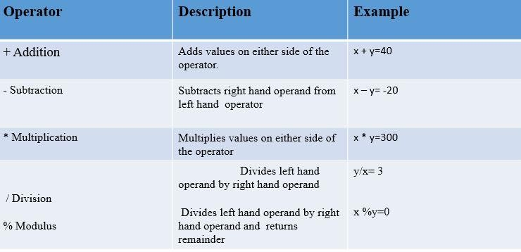
Python Arithmetic Operators
We use these operators for mathematical purpose.

Slide 58
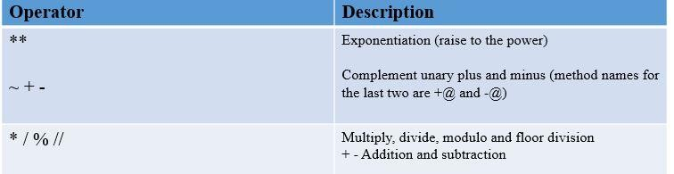
Python Operator Precedence

Slide 59


Python Comparison Operators
•
We use these operators for conditional purpose.
Operator Description ( usage)
>
if the left operator has greater value than the right one. Ex= 2>1
<
If the right operator has greater value than the left one. Ex= 6<9
==
If both sides of the operators are same to same . Ex= 4==4
!=
if both sides of the operators are not same.
>=
If the left operator is greater than or equal to right one. Ex =
6>=6,7>=4
<=
If the right operator is greater than or equal to left one. Ex=
4<=4,6<=8

Slide 60
Python Assignment Operators
•
These are used to assign values to variables. Few one them are as shown below.
Operator Description and Example
= S =2+3 means the value 2+3=6 is assigned into S
+= H+=4 means 4 is added to H and final result is saved into H.
So H+4=H. i.e if H value is 2 then 6+4=10 is stored in H.
-= H-= 4 means 4 is subtracted to H and final result is saved into
H. So H-4=H i.e 6-4=2 is stored in H.
*= H*= 4 means 4 is multiply with H and final result is saved into
H. So H*4=H i.e 6*4=24 is stored in H.
•
Similarly few more operators like %=,//=,**=,&=,|= ……

Slide 61


Python Logical Operators
•
Logical operators are also used to check conditional statements.
Operator Description
AND
used to check both the operands or true
Ex a=2,b=2 if a AND b=2 then print(‘ a AND b is’, True) i.e output is TRUE
OR
Used to check either one of the operator is true
Ex a=2,b=3 if a OR b =3
then print(‘ a OR b is ’, 3)
i.e output is b=3.
NOT
Used to complement the operator
If given X is true then it shows it is false .

Slide 62


Python Membership Operators
•
These operators are used to check whether the given values are in the sequence or not.
Operator Description
in
If the given value is within the sequence it will displays . Example
as shown below
X = { 2,4,6,8}
Print(4 in X )
then it will display ‘True’ because 4 is within the x
Not in
Opposite to IN operation.
Example : 9 Not in then it will check whether 9 is in sequence or
not. Regarding to the above sequence we do not have 9 so it will
display 9.

Slide 63


Python Identity Operators
•
These
operators are used to check whether the values are in the memory
or not.
Operator Description
is
If the operand are same then it is true. EX: x=2,y=2 then print X is Y.
Is not
If the Operand are not same then it shows true. Ex: x=2 ,y=2 print x is not Y then it shows false. Ex: x=2y=3 print x is not y then it shows True.

Slide 64
Conditional Statements
•
We use conditional statements for checking the
behavior.
Some of the conditional statements are as follows…
1. if
2.if else
3.Nested if else
condition
of
the
statement
and
to
change
its
•
Now lets discuss about If statement.
1.If
Syntax for if is as follows
if expression:
statement(s)

Slide 65
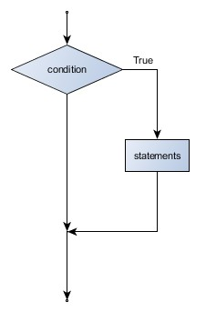

•A flowchart is given for better understanding ..
•
The boolean
expression after the if statement is
called the condition. If it is true, then all the
given statements are executed .
Example as shown below.
Otherwise no
•
Here there is an expression “=“ which
tells that variable is assigned some value.
Here there
is
an
expression
“==“
which tells that there is a condition
The
statement
is executed
as
the
condition was true.

Slide 66
2.If Else
•
•
One thing to happen when a condition it true, otherwise else to happen when it is false.
Syntax:
if expression:
statement(s)
else:
statement(s)
The below flowchart describes how if else condition works
•

Slide 67
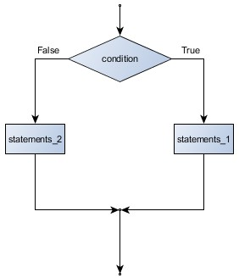
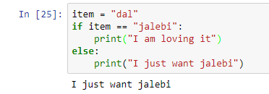
•
If the given condition is true then statement one will display other wise second statement.
Example
Here the “if” condition hasn’t
met, so
“else” statement has been executed

Slide 68
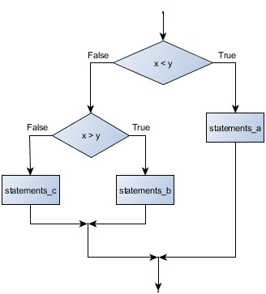
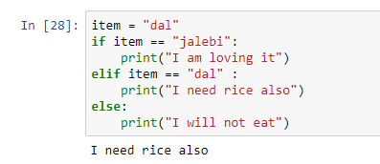
Nested If Else
•
If the first condition is true( x<y), it displays the
first one. If it is false, then checks second condition
(x>y) if it is true then displays
displays the third statement.
second
statement
.
If
the
second
condition
is
also
not
satisfied,
then
it
•
Example :
To use nested
else if in python,
we have a
key word ”elif”. It will be executed after “if”,
and before “else”

Slide 69
Loops
•
Executes a sequence of statements multiple times
variable. It is a continuous process.
Syntax:
–for iterating_var in sequence:
statements(s)
The below flow chart gives how for loop works
and
abbreviates
the
code
that
manages
the
loop
•
•

Slide 70
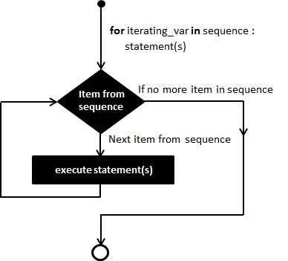
For Loop
•
Each iteration assigns the loop variable to the next element
in the sequence, and then
executes the
statements
sequence.
in
the
body.
Statement
will
be
completed
if
it
reaches
the
last
element
in
the
given

Slide 71
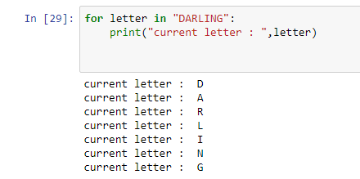
•
Example :
To use “for “ loop, we have to use keyword
“in”
Under variable “letter”, every
pick one by one in each loop.
letter
will

Slide 72
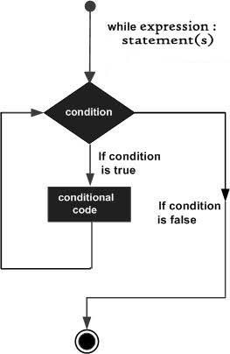
While Loop
•
•
while loop executes repeatedly the target statement as long as a
Syntax
–while expression:
statement(s)
the given condition becomes true.
•Flow chart
gives how does the while loop works.

Slide 73
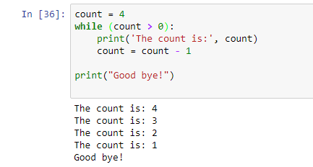
•
Example
“while”
loop
continues
or
repeats
its
conditions until its last statement become
true. Here loop will run, until “count”
become equal to or less than zero.
will
Last “print”
statement will be executed out of
“while” loop because it is not have four space
indentation

Slide 74
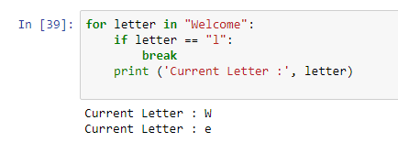
break Statement
•
It terminates the current loop and resumes execution at the next statement.
•Example:
“break” statement breaks
condition comes true.
the
loop
if
“if”

Slide 75
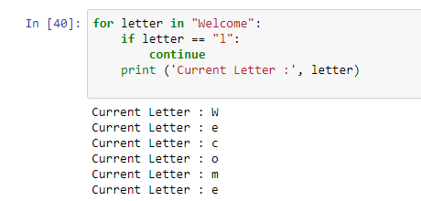
continue Statement
•
It returns the control
to the beginning of the while loop.. The continue statement rejects
all the
first of
remaining
the loop.
statements
in
the
current
iteration
of
the
loop
and moves the control back to the
“continue” statement allow the loop
the step, if “if” condition comes true.
to
skip

Slide 76
Functions and Methods
• Function is a collection of statements which is used to perform a specific task.
• A method is a function that takes a class instance as its first parameter
•Functions in Python are similar to functions in “C”and functions/procedures in “Pascal”.
•Syntax
def function _name(parameters):
"""doc string"""
statement(s)
•Function begins with def Keyword followed by function name and parentheses
• Function naming follows the same rules of writing Python identifiers.

Slide 77
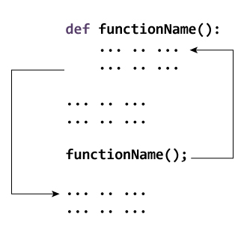
•
We pass values through parameters or arguments and these are placed within the parenthesis.
•
Colon is used to end the function header.
•
Documentation string( doc string ) is used to explain what the function does.
•
And optional return statement to return value from function.
How Function
works in Python.

Slide 78
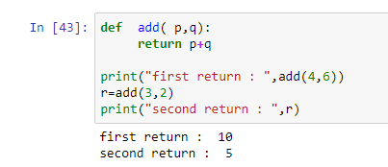
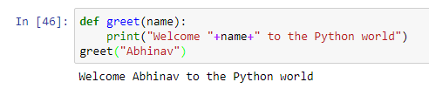
• Example 1:
“add”
function
is
created,
sum
of
two
parameters is returned in this function
•
Example 2:
To call a function, simply use the function name with apt parameters or arguments. Here the
apt parameter is name(string). If string variable would not be provided, error will come

Slide 79
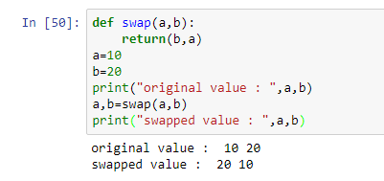
Function With parameters
•
Parameters or arguments are used for passing values. Immutable objects cannot be changed inside
the functions or outside. But
changed outside the function.
mutable
objects
or
opposite
to Immutable objects, which can be
•
Example
:
“swap” function is created, to swap the values
of parameter.
Value is assigned to variables
function, which is returned by it
from
“swap”
First print statement
assigned initially.
returned “original value” i.e. the value which is
After
that swap statement swaps the value, so then
b value is
changed to a and vice versa.

Slide 80
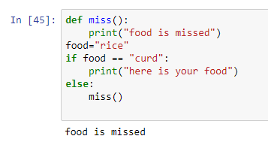
Function without parameter
There is no compulsion for a function to be associated with parameters or arguments.
“miss” function is without parameter.
It will return a constant value which is kept
under the function.
“miss” function is called here. It would be
more practical to use, when we have to print
similar statements multiple times. In
such
case, each time, we have to just call the
function, in place of writing complete print
statement.

Slide 81
•
In functions there are four parameters they are as follows
1.Required Arguments or positional
2 .Keyword Parameters
3. Default parameters
4. Collecting parameters

Slide 82
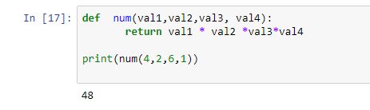
1.REQUIRED ARGUMENTS OR POSITIONAL PARAMETERS
•
The arguments or parameters which are in a positional format in a( parameters must be in a order)
function is nothing but Positional Arguments or parameters. Parameters in function call will perfectly
match with the function definition.
Example
•
Here we had given 4 positions so when we give
values like 4,2,6,1 then they will take those values in
a order.

Slide 83


•
Given values are 4,2,6,1 those can be placed in order by these positional argument.
Val 1 val2 val3 val4
4
4
2
4
2
6
4
2
6
1
•
First value 4 will enter into val1 and then second value will be to val2 so on …

Slide 84
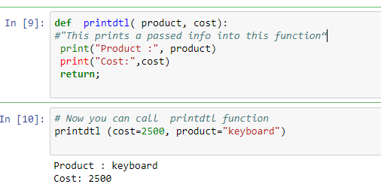
2 .KEYWORD PARAMETERS
• We can identify the function call as Keyword argument by its argument name.
• In this argument no need of maintaining the parameters in an order.
• Example :
The “product” and “cost” are
keyword parameters.
The value of the parameter is taken from function in different order as declared in the function.

Slide 85
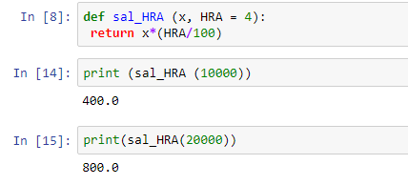
3. DEFAULT PARAMETERS
•
Default parameter is nothing but parameter which is assigned default
a argument when function is called.
These values will evaluate once the function is called or defined. Example :
when value is not assigned in
•
•
Here HRA is default parameter.
HRA(given as percent) to value x is
returned

Slide 86
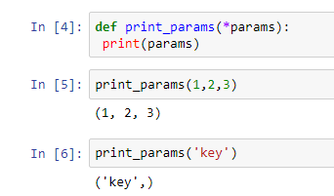
4.COLLECTING PARAMETERS
•
•
Sometimes it can be useful to allow the user to supply any number of parameters.
Actually that’s quite possible with the help of collecting parameters
Here parameter is passed through (*)
which allows user to input any number of
parameters
Here 3 values to the parameter is
passed which is accepted by function

Slide 87
SCOPE OF VARIABLES
•
All variables cannot be accessed
places .
at a same place or at all locations. They are
accessed
at
different
•
•
Usually they are some Scopes for
They are :
allocating variables at a particular location.
LOCAL VARIABLES
• Variables that are accessed inside the function is called Local Variables.
GLOBAL VARIABLES
• Variables that are accessed throughout the function or outside the
program is called Global Variables.

Slide 88
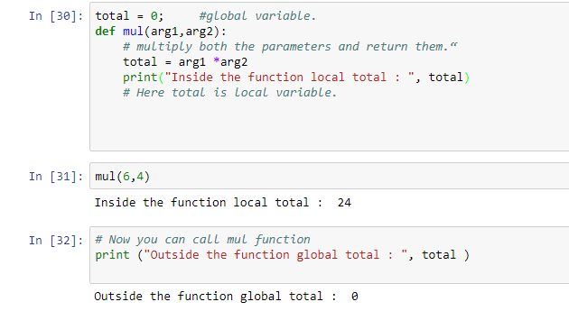
Local & Global Variable
•
If we want to search where the variable location is allocated, first search will be in Local variable if it
is not found in local variable then the search will be in Global variable . If the variable still cannot be
found in Global variable then search will be in Built in predifined Name space .
If still variables are not found there then an exception will be raised i.e. name is not defined
•
To check the output of local variable :
its value is printed under function
To check the output of global variable
: its value is printed outside the
function

Slide 89
RETURN
•
•
Return statement can return any type of value which python identifies.
In Python all functions return at least one value. If they are not defined then there is no return value.

Slide 90
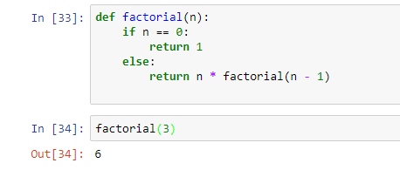
RECURSION
•
•
We can call a function in recursive, i.e. the function will call itself.
Example :
The function which is created, itself
is returned ->
Recursive function
•
Function defining
location.
by using recursion is too costly for executing
the program
or due its memory

Slide 91
# Program to display the Fibonacci sequence up to n-th term where n is provided by the user
# change this value for a different result
nterms = 10
# uncomment to take input from the user
#nterms = int(input("How many terms? "))
# first two terms
n1 = 0
n2 = 1
count = 0

Slide 92
# check if the number of terms is valid
if nterms <= 0:
print("Please enter a positive integer")
elif nterms == 1:
print("Fibonacci sequence upto",nterms,":")
print(n1)
else:
print("Fibonacci sequence upto",nterms,":")
while count < nterms:
print(n1,end=' , ')
nth = n1 + n2
# update values
n1 = n2
n2 = nth
count += 1

Slide 93
FILES
•
In python there is a possibility to manipulate
following are the steps to use Files
files
.Files
are
used
to
store
objects
permanently.
The
1.Printing on screen
2.Reading data from keyboard
3.Opening and closing file
4.Reading and writing files
5.Reading CSV, txt and excel files

Slide 94
1.PRINTING ON THE SCREEEN
•
•
•
•
•
We can see the statements what we have written in the output by using PRINT statement.
This statement (print) can converts expressions
the result to the standard output.
Example : print (‘’ Welcome to python’’)
what we are passing
into a string and writes
Output
Welcome to python.

Slide 95
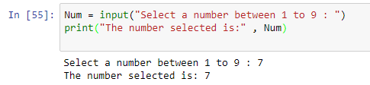
2.READING DATA FROM KEYBOARD
•
•
For reading data from keyboard they are 2
They are:
– Raw input Function.
– Input function.
#For version greater than python-3.0
built in functions in python.
•
The “input” function is used to get
input from the keyboard.
•
#For version less than python-3.0
– Num = raw_input(“Select a number between 1 to 9”)
– print(“The number selected is: “, Num)

Slide 96


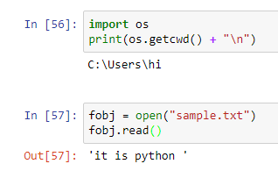
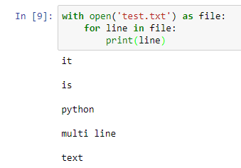
READING AND WRITING FILES
Nam open("filename") opens the given file for reading, and returns a file object
name.read()
file's entire contents as a string
To know where is working
directory
Open and read function is
used here to read the file
To read multiple lines, we have to
open it with “with open “
keyword and print it in “for” loop

Slide 97
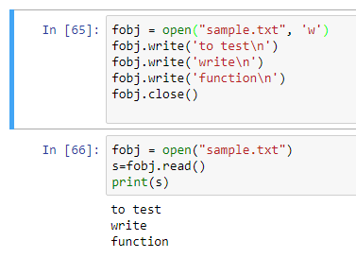
WRITING FILES IN PYTHON
•
The write() method writes any string to an open file.
•
Syntax
fileObject.write(string);
Used the “write” function to
write multiple strings in the
file. “\n” changes line

Slide 98
OPENING AND CLOSING FILES
•
•
•
•
1.
2.
The open Function:
By using Python's built-in open() function we can open a file.
Syntax
file object = open (file_name): ([, access_mode][, buffering])
file_name:Name of file.
access_mode: The access_mode determines the mode in which the file has to be opened i.e. read,
write
Used the access mode ‘w’
in “open” function in the
file

Slide 99
•
•
The close Function:
when the reference object of a file is reassigned to another file. Python automatically closes file.
SYNTAX:
that
•
–
fileObject.close();
Used the function “close”
to close the file

Slide 100
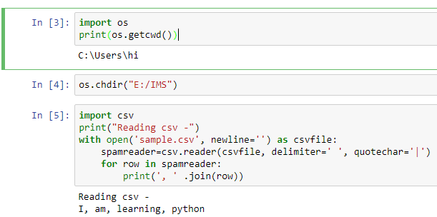
READING CSV, TXT AND EXCEL FILES
•
A CSV file contains a number of rows and columns separated by commas.
•
•
Reading CSV Files
To read data from a CSV file, use the reader function to create a reader Object. Use writer() to create an object for writing, then iterate over the rows, using writerow() to print them.
os.getcwd() helps in getting working directory, while os.chdir is used to change working directory
“with open” keyword and csv.reader()
function can be used to read file

Slide 101

Python
Data
Structure

Slide 102
Brief overview of Data Structure
•
There are quite a few data structures available. The built-in data structures are: lists, tuples,
dictionaries, strings, sets and frozensets.
Lists, strings and tuples are ordered sequences of objects.
Unlike strings that contain only characters, list and tuples can contain any type of objects.
Lists and tuples are like arrays. Tuples like strings are immutables. Lists are mutables so they can be extended or reduced at will.
Sets are mutable unordered sequence of unique elements whereas frozensets are immutable sets.
•
•
•
•

Slide 103
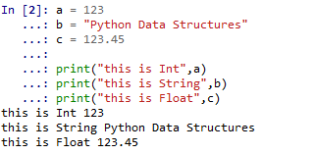
Object Declaration
•
•
We may need to declare variables to store different type of values
For declaration , there is no need to mention data type i.e. int, string or float
–
–
–
–
–
–
a = 123
b = "Python Data Structures"
c = 123.45
print("this is Int",a)
print("this is String",b)
print("this is Float",c)

Slide 104
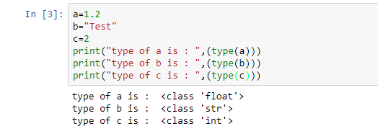
Data Type
•
To know the type of a variable use “type” function
–
–
–
print("Type of a is",type(a))
print("Type of b is",type(b))
print("Type of c is",type(c))
To find the type of
different variable, “type”
function
is used.

Slide 105
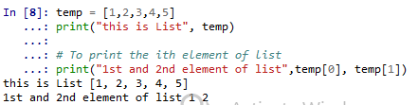
List
•
•
In python, lists are part of the standard language.
We could store multiple values in a single object. Lets say we would like to store a sequence of
numbers/Id’s, this could be achieved by lists
List and Stacks, both are same in python
•
–
–
–
>>> l = [1, 2, 3]
>>> l[0]
1
It is initiated with brackets []
To access first element, we have to use bracket
as index .

Slide 106


List
•
To insert an element at ith place
–
–
temp.insert(3,9)
print("List after insertion",temp)
•
To append element to list we use append, this corresponds to push when we use list as stack
–
–
temp.append(10)
print("After append the list is",temp)

Slide 107


List
•
To find index of any element
–
–
–
print(temp)
index = temp.index(5)
print("Index of 5 is ", index)
•
To remove an element
–
–
–
print(temp)
temp.remove(5)
print("List after removing 5",temp)

Slide 108


List
•
To reverse the list
–
–
–
print(temp)
temp.reverse()
print("List after reversing", temp)
•
To sort the list
–
–
–
print(temp)
temp.sort()
print("Sorted list",temp)

Slide 109


List
•
To remove last element of list or pop the element from stack
–
–
–
print(temp)
temp.pop()
print("List after pop",temp)
•
Nested lists
–
–
nested = [[1,2,3],[2,3,4],[5,6,7]]
print("Nest list",nested)

Slide 110

List
•
To slice ->Slicing uses the symbol : to access to part of a list:
>>> list[first
index:last index:step]
>>> list[:]
Last element is accessed through -1

Slide 111

List as stacks
Lists is treated as stacks, that is a last-in, first-out data structures (LIFO).
An item can be added to a list by using the append() method.
The last item can be removed from the list by using the pop() method without passing any index to it.

Slide 112

How to copy a list
•
There are three ways to copy a list:
Even the last item of “a”
is popped out, the value
of “b” which was copied
earlier, remained intact.

Slide 113

How to copy a list
•
The preceding techniques for copying a list create shallow copies. It means that nested objects will
not be copied. Consider this example:
Here, the value of “a” is
changed after copying.
But the value of “b” also
changed correspondingly
So, to counter such
changes, “deepcopy”
function is used

Slide 114

Dictionary
•
The other main data type is the dictionary. The dictionary allows you to associate one piece of data (a
"key") with another (a "value"). The analogy comes from real-life dictionaries, where we associate a
word (the "key") with its meaning. It's a little harder to understand than a list, but Python makes
them very easy to deal with.
It is best to think of a dictionary as an unordered set of key: value pairs, with the requirement that the keys are unique (within one dictionary).
A pair of braces creates an empty dictionary: {}
Placing a comma-separated list of key : value pairs within the braces adds initial key : value pairs to the dictionary; this is also the way dictionaries are written on output.
Declaration of dictionary
•
•
•
•
▪
Lets say we would like to create an object which stores the name and scores of students. This
could be achieved with dictionary in keys : values format
•
•
score = {'rob' : 85, 'kevin' : 70}
print("The dictionary is",score)

Slide 115

Dictionary
•
To get the score of any student or value in dictionary
–
–
–
–
print(score)
mar = score['kevin']
print("Marks of Kevin are",mar)
print("Marks of rob are",score['rob'])
# print the score of rob

Slide 116

Dictionary
•
Add new elements or students to the dictionary
–
–
–
–
print(score)
score['jim']= 92
score['tomy']= 56
print("The dictionary after adding jim and tomy -",score)

Slide 117

Dictionary
•
“keys” gives you keys in dictionary, i.e. names of all students in this case
–
–
–
print(score)
names = list(score.keys())
print("List of students -",names)

Slide 118

Dictionary
•
“values” gives you values in dictionary, i.e. marks of all students in this case
–
–
–
print(score)
marks = list(score.values())
print("List of marks -",marks)

Slide 119

Dictionary
•
We can also look at the marks in sorted order i.e. non descending order
–
–
–
print(score)
sortedMarks = sorted(score.values())
print("List of marks in sorted order -",sortedMarks)

Slide 120


Dictionary
•
Checks if a particular student name is there in the dictionary
–
–
–
print(score)
check = 'kory' in score
print("If kory is there in dictionary -",check)
check2 = 'jim' in score
print("If jim is there in dictionary -",check2)

Slide 121

Dictionary
In addition to keys and values methods, there is also the items method that returns a list of items of
the form (key, value). The items are not returned in any particular order.
In order to get the value corresponding to a specific key, use get or pop :
The difference between get and pop is that pop also removes the corresponding item from the dictionary

Slide 122

Dictionary
popitem removes and returns a pair (key, value); you do not choose which one because a dictionary
is not sorted :

Slide 123

Dictionary
To create a new object, use the copy method (shallow copy):
-> d2 = d1.copy()
You can clear a dictionary (i.e., remove all its items) using the clear() method:
-> d2.clear()
The clear() method deletes all items whereas del() deletes just one:
All the values of “d” is
cleared by the function
“clear”

Slide 124

Queue
•
A queue is a first in, first out (FIFO) structure. This means that the first item to join the queue is the
first to leave the queue.
Importing & declaring a queue
•
–
–
–
from collections import deque
queue = deque(["aa", "bb", "cc"])
print(queue)

Slide 125

Queue
•
Appending element to queue
–
–
–
queue.append("dd")
queue.append("ee")
print("After appending dd and ee, queue is",queue)

Slide 126

Queue
•
Removing left element from queue
–
–
–
–
left = queue.popleft()
# The first to arrive now leaves
print("After removing left element, queue is",queue)
secLeft = queue.popleft()
# The second to arrive now leaves
print("After removing left element, queue is",queue)

Slide 127

Tuples
In Python, tuples are part of the standard language. This is a data structure very similar to the list data
structure. The main difference being that tuple manipulation are faster than list because tuples are
immutable.
To create a tuple, place values within brackets:
It is also possible to create a
tuple without parentheses,
by using commas:
To create a tuple with a single element, you must use the comma:
>>> singleton = (1, )

Slide 128

Tuples
Since the tuple is multiplied by 5, it
has grown into size 5 tuple from
singleton tuple
9 as value of singleton tuple , is
added at the end of tuple

Slide 129

Tuples
Tuples are useful because there are
•
•
•
faster than lists
protect the data, which is immutable tuples can be used as keys on dictionaries
In addition, it can be used in different useful ways:
1. Tuples as key/value pairs to build dictionaries
Dictionary is created using tuples
Multiple values can be assigned
using tuples
“range” function generates sequence
of numbers. E.g. range(3) = (0,1,2)

Slide 130

Tuples
Tuple Unpacking
Tuple unpacking allows to extract tuple elements automatically is the list of variables on the left has the same number of elements as the length of the tuple
Tuple can be use as swap function
This code reverses the contents of 2
variables p and q:

Slide 131

Tuples
Length
To find the length of a tuple, you can use the len() function:
>>> t= (1,2,3,4,5)
>>> len(t)
5
Tuple is immutable. So, we
can’t assign values to it.
Slicing (extracting a segment)
>>> t = (1,2,3,4,5)
>>> t[2:]
(3, 4, 5)
Copy a tuple
To copy a tuple,:
>>> t = (1, 2, 3, 4, 5)
>>> newt = t
>>> t[0] = 5
>>> newt
(1, 2, 3, 4, 5)

Slide 132

Tuples
Tuple are not fully immutable !!
If a value within a tuple is mutable, then you can change it:
>>> t = (1, 2, [3, 10])
>>> t[2][0] = 9
>>> t
(1, 2, [9, 10])
Math and comparison
comparison operators and mathematical functions
can be used on tuples. Here are some examples:
>>> t = (1, 2, 3)
>>> max(t)
3
Convert a tuple to a string
You can convert a tuple to a string by:
>>> str(t)

Slide 133

Sets
•
Sets are constructed from a sequence (or some other iterable object). Since sets cannot have
duplicated, there are usually used to build sequence of unique items (e.g., set of identifiers).
“dog” is repeated two times,
but sets cannot keep
duplicate item, so one “dog”
is removed
•
•
•
Sets are mutable unordered sequence of unique elements
Sets are constructed from a sequence (or some other iterable object)
Since sets cannot have duplicated, there are usually used to build sequence of unique items

Slide 134

Sets
•
Quick look
“OR” combines all the element and
takes unique value of combined element
“AND” picks all the elements which are
Common in both the sets
“<” function looks, if all the elements of
“a” is present in “b”
“^” function combines all the element and removes all the common element

Slide 135

Sets
•
Sets are iterable
–
–
i = 'cat' in animals
print(i)
–
–
j = 'crow' in animals
print(j)
animals contain( lion, cat,
dog and tiger. Since “cat” is
in “animals” set, the
statement is true. But crow
is not part of “animals” set,
so output is false.

Slide 136

Sets
•
Set always give non-duplicate set of elements
–
–
a = set('abracadabra')
b = set('alacazam')
–
–
print("Set a is",a)
print("Set b is",b)

Slide 137


Sets
•
Letters in a but not in b
–
–
c = a - b
print("letters in a but not in b",c)
•
Letters in either a or b
–
–
d = a | b
print("letters in either a or b",d)

Slide 138


Sets
•
Letters in both a and b
–
–
e = a & b
print("letters in both a and b",e)
•
Letters in a or b but not both
–
–
f = a ^ b
print("letters in a or b but not both",f)

Slide 139

Frozensets
•
Sets are mutable, and may therefore not be used, for example, as keys in dictionaries.
•
Another problem is that sets themselves may only contain immutable (hashable) values, and thus
may not contain other sets.
Because sets of sets often occur in practice, there is the frozenset type, which represents immutable
(and, therefore, hashable) sets.
•
Frozenset is immutable. So,
we can’t assign values to it.

Slide 140

Frozensets
Frozensets : Using set as key in a dictionary
If you want to use a set as a key dictionary, you will need frozenset:
1 as key value, has been set
to fa (frozenset). It can be
retrieved.
Frozensets : Methods
frozensets have less methods than sets.
There are some operators similar to sets (intersection(), union(), symmetric_difference(), difference(), issubset(), isdisjoint(), issuperset()) and a copy() method.

Slide 141
Thank
You.

